Slide 1
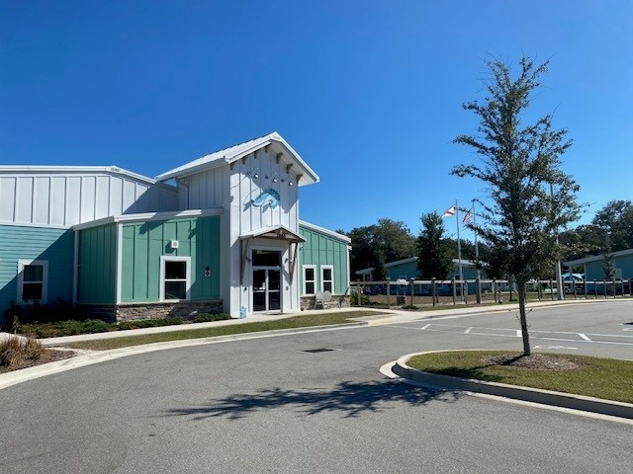
Seaside Charter Beach
Seaside School Consortium, Inc.
Series 2018 A & B Educational Revenue Bonds
Investor Call
NOVEMBER 10, 2021 - 10:00 AM EST

Slide 2
Agenda
Vision & Mission
Seaside Overview
Leadership
Pandemic
Fundraising
Enrollment- Current & Projected
Academic Results
2020-2021 Audit
2021-2022 Budget
Question & Answers

Slide 3
Vision & Mission
Vision
Seaside’s shared vision is to foster each student’s intellectual, social, emotional, and physical development in a nurturing, Waldorf-inspired public charter school setting that inspires deep learning, a sense of environmental stewardship, and an appreciation for all cultures, the arts, and the ever-changing world.
Mission
To provide a rigorous, arts-integrated educational program guided by the Core Principals of Public Waldorf Education to meet and exceed the Florida State Standards.

Slide 4
Seaside Consortium
Consortium Board
Seaside
Beach
Seaside
San Jose
Sea Turtle
ELC
Seaside
North

Slide 5
Leadership
Our Principal and Assistant Principal, now in their second year in their positions at our Beach campus, continue to provide strong positive leadership.
One of our tenured ESE teachers has taken on Director of ESE responsibilities to ensure compliance with all District and State mandates.
In addition to our new Board Treasurer, Jolie Usry, we have two new Board applicants going through the training process who we are confident will bring great leadership and organizational skills to the Board.

Slide 6
COVID Pandemic
In response to Florida Governor Ron DeSantis’ executive order summer of 2020, Seaside offered both in-person and virtual learning for the entire 2020-21 school year. At the start of the school year 75% of our students were face to face, and 25% virtual. By the end of the year most of our students were back to face to face.
Florida Education Finance Program funded schools based on projected student enrollment; therefore, we received funding based on full capacity at our schools.
CARES Act – Elementary & Secondary Schools Emergency Relief funds (ESSER) were available to our schools to help alleviate the increased expenses due to Covid mitigation efforts. Our Beach campus has received $142,154 in ESSER funds to date.
Our initial full-capacity enrollment for this 2021-2022 school year has been impacted by COVID affecting children at greater numbers, lack of the virtual learning option, and our mask wearing mandate. However; most recently our mask mandate has relaxed as the COVID cases have significantly dropped in our area. We believe this will positively impact our enrollment.

Slide 7
Paycheck Protection Program
School | PPP Amount Allocated | Purpose
Beach | $443,325.46 | Payroll
North | $242,580.46 | Payroll, Benefits & Utilities
Sea Turtle | $106,394.08 | Payroll & Benefits
Seaside School Consortium, Inc. benefited greatly from the $792,300 received on May 8, 2020.
Seaside received full forgiveness of the $792,300 on April 14, 2021.

Slide 8
Fundraising
Seaside Consortium has hired a new Marketing Director.
Brittnie Thiel has a Bachelor Degree in Business Administration, and a passion for Waldorf education. Two of her children attend Seaside North, where she currently still holds her position as PTO president as well.
During this 2021-2022 school year, Seaside Consortium will have 3 fundraising events:
Annual Giving Campaign
Winter Arts Market
Annual Spring Golf Tournament
Goal: $100,000

Slide 9
CARES ACT ESSER II
A second round of ESSER (Elementary & Secondary School Emergency Relief) funds are now available to our schools to help bridge the education gaps our students are experiencing as a result of the pandemic.
Our Beach school has approximately $406,000 available for more robust technology, academic acceleration assets, enrollment/attendance assistance, and professional & technical services and supplies to mitigate Covid.

Slide 10
Enrollment as of October 2021
Current
Projected
Grade | 2021-2022
K | 71
1 | 70
2nd | 72
3rd | 72
4th | 63
5th | 55
6th | 42
7th | 35
8th | 33
Total | 513
Grade | 2022-2023 | 2023-2024 | 2024-2025
K | 72 | 72 | 72
1 | 72 | 72 | 72
2nd | 72 | 72 | 72
3rd | 72 | 72 | 72
4th | 66 | 66 | 66
5th | 66 | 66 | 66
6th | 44 | 44 | 44
7th | 44 | 44 | 44
8th | 44 | 44 | 44
Total | 554 | 554 | 554

Slide 11
Academic Results – 2020-2021
School Grades
2020-2021 | N/A
2019-2020 | B
2018-2019 | B
2021 Florida State Assessment Results
 | Avg. vs District | Avg. vs State
Reading | +12.5% | +5.1%
Math | +9.2% | +3.4%
Science | +9.0% | +2.5%

Slide 12
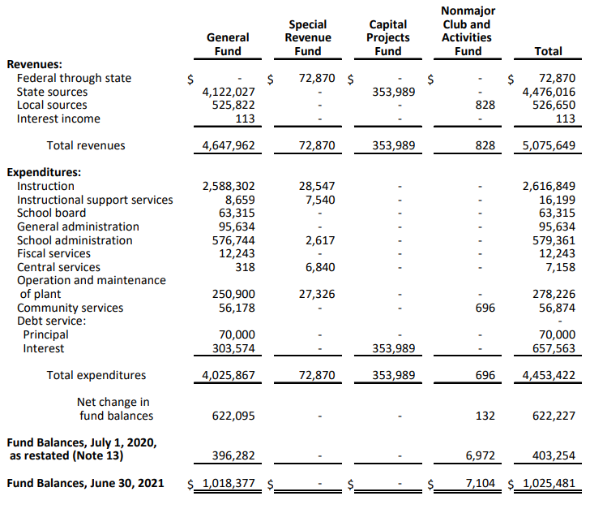
Audit 2020-2021
Statement of Revenues, Expenditures and Changes in Fund Balance –
Governmental Funds

Slide 13
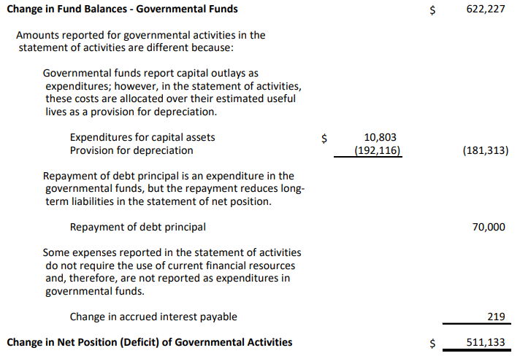
Audit 2020-2021
Reconciliation of the Statement of Revenues, Expenditures and Changes in Fund Balances – Governmental Funds to the Statement of Activities

Slide 14
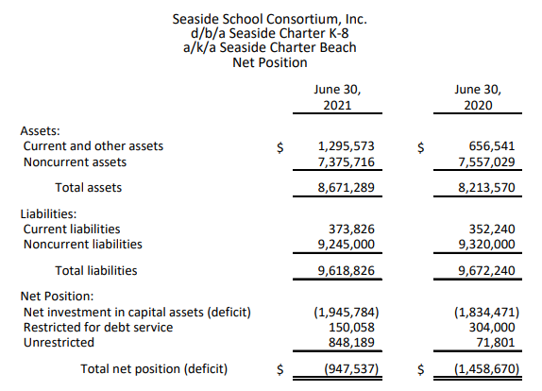
Audit 2020-2021
Balance Sheet- Governmental Funds

Slide 15
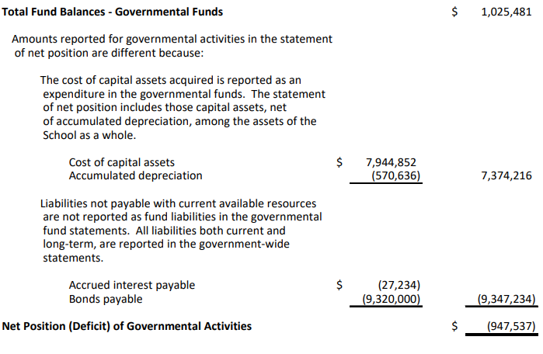
Audit 2020-2021
Reconciliation of the Balance Sheet
Governments Funds
To the Statement of Net Position

Slide 16
Days Cash on Hand and Debt Service Coverage Ratio
Days Cash on Hand
103.68
Debt Service Coverage Ratio
2.46
As of June 30, 2021

Slide 17
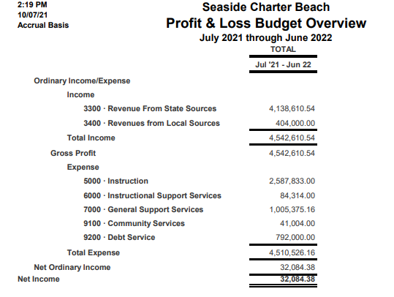
2021-2022 Budget

Slide 18
The financial impacts of the pandemic continue to be offset by funds provided by the CARES Act. We are also benefiting from the .5% sales tax referendum Duval County voters approved last fall for Duval County Public Schools.
Our biggest concerns regarding the budget continue to be student enrollment due to the continued challenges surrounding COVID, and the staffing of teachers as many have left the field of education.
Current discussions are ongoing with Greenwich on possible refinancing of current bond debt.

Slide 19
Question & Answers

